Slide 1


Neural Density Estimation
Introduction into Normalising Flows and
Masked Autoregressive Flow
Daniel Decker
University of Rostock

Slide 2
Content
Density Estimation & Masked Autoregressive Flows
Evaluation of Masked Autoregressive Flow:
  Density Estimation with artificial distributions
  Sampling quality with a real world dataset

Slide 3
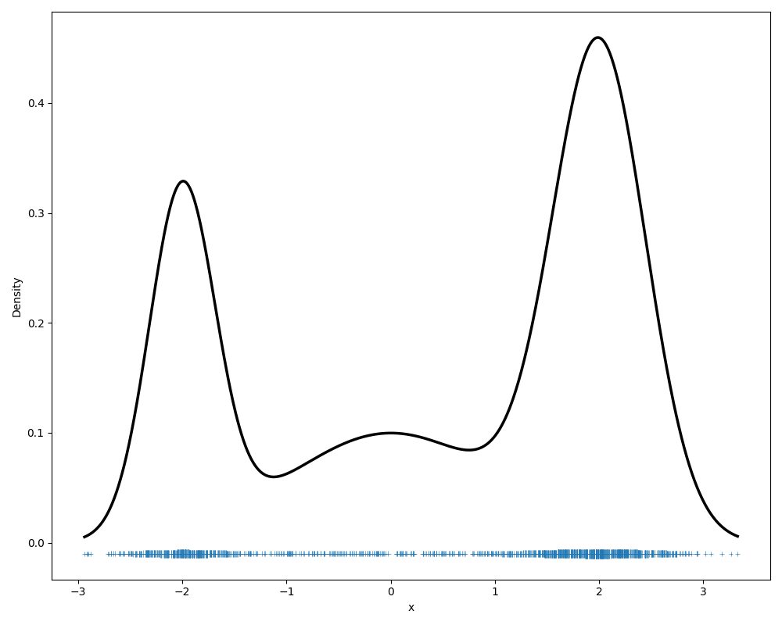
Intro: Density Estimation

Slide 4
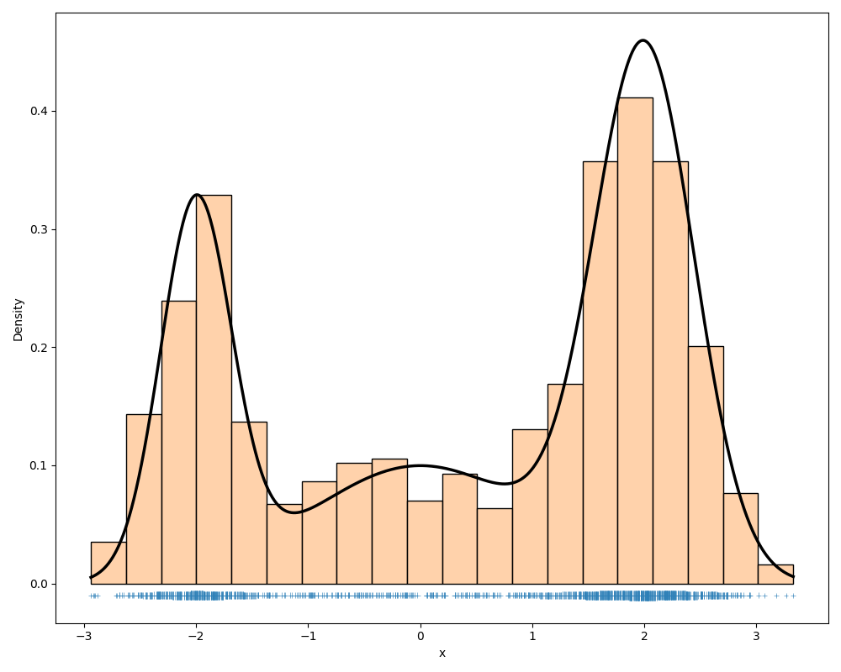
Intro: Density Estimation - Histogram

Slide 5
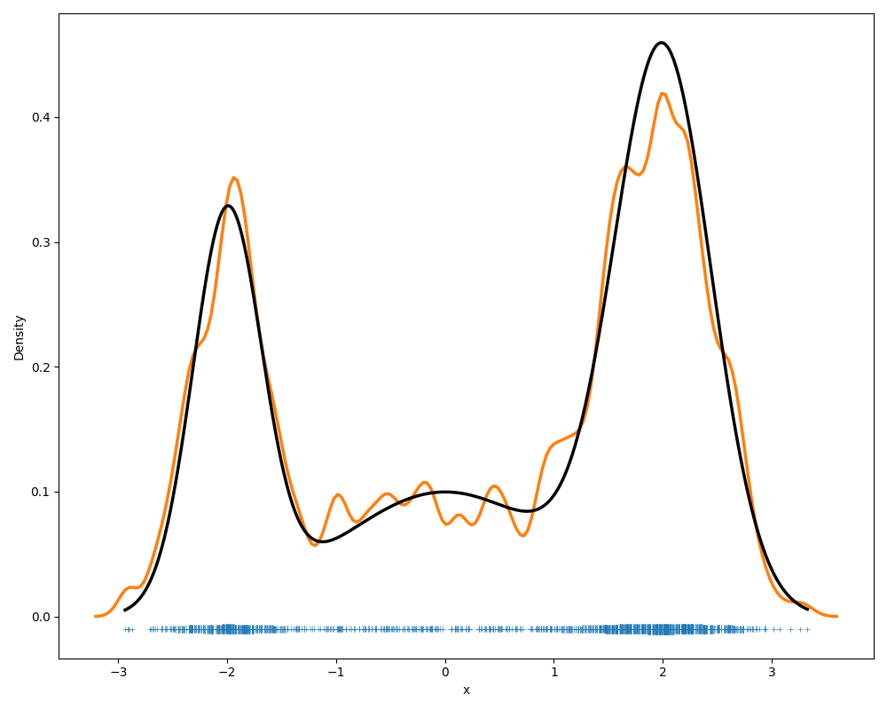
Intro: Density Estimation - KDE

Slide 6
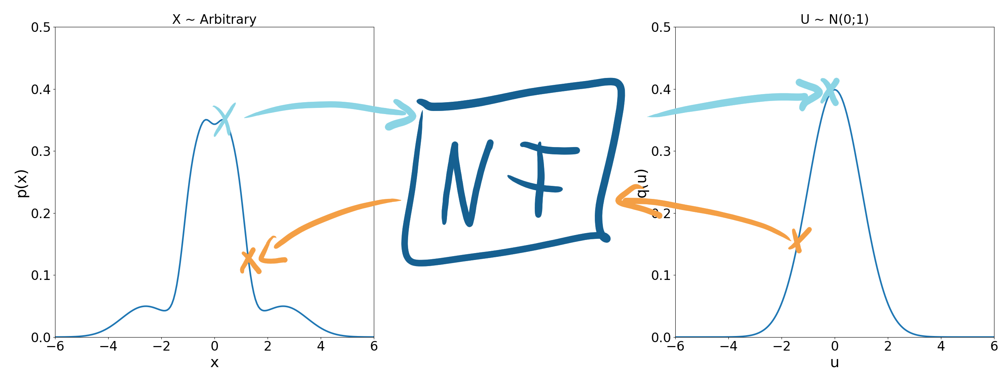
Intro: Normalising Flows

Slide 7
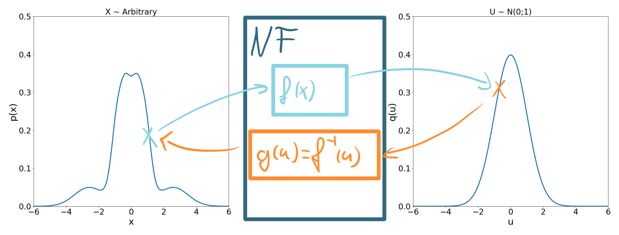
Intro: Normalising Flows

Slide 8
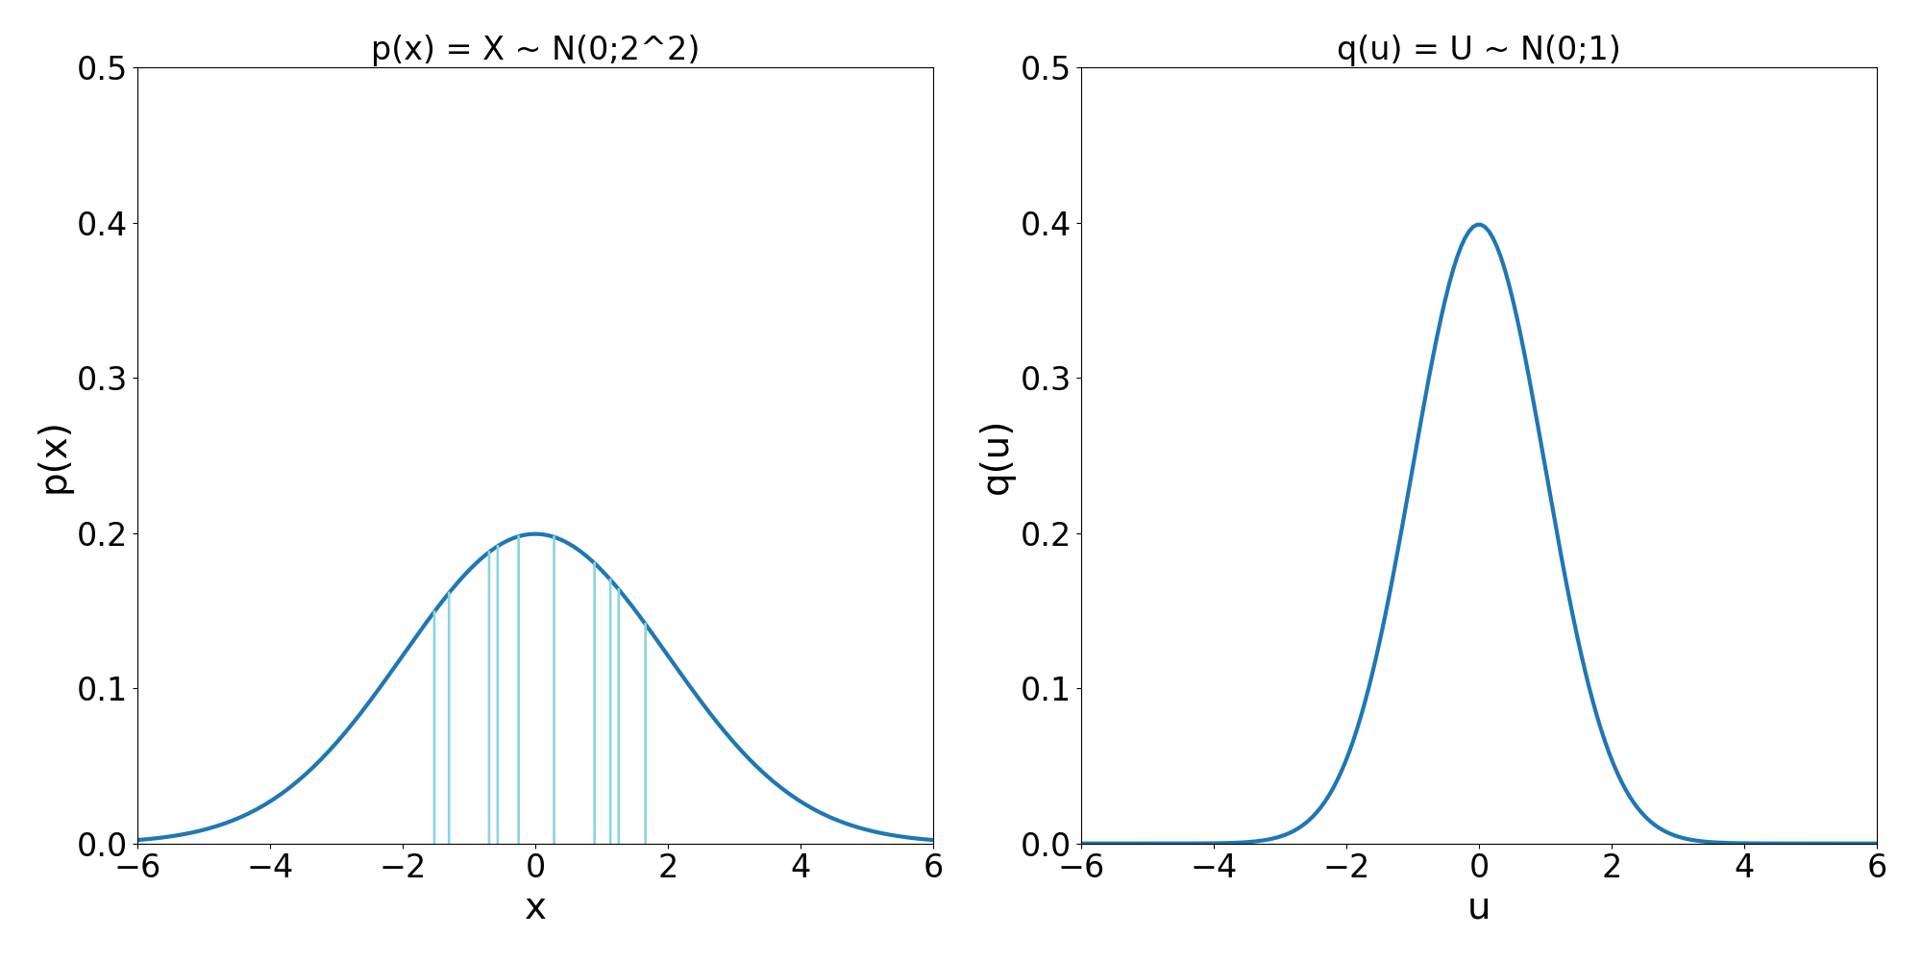
Intro: 1D Transformation

Slide 9
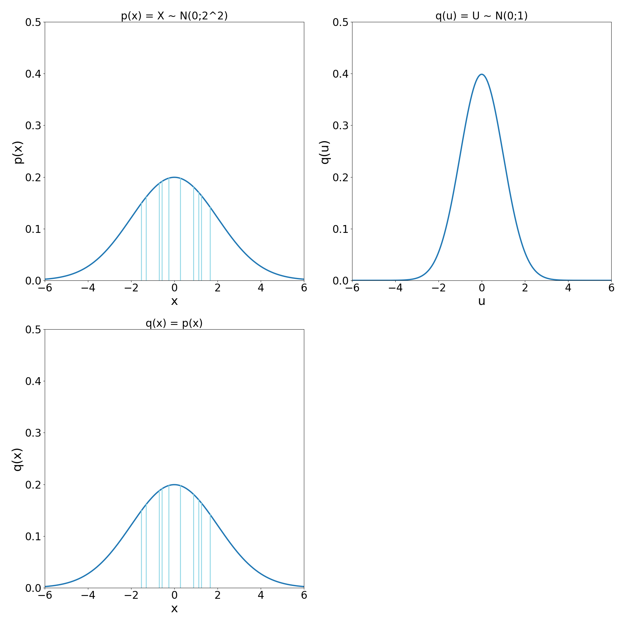
Intro: 1D Transformation

Slide 10
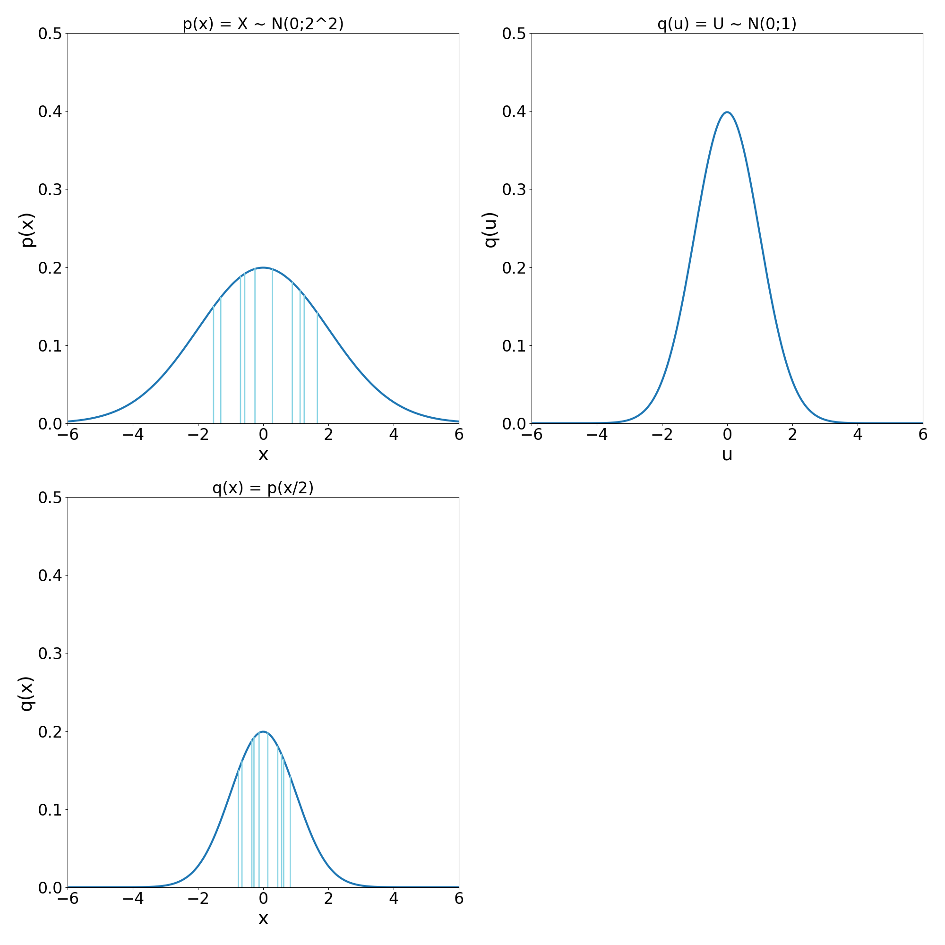
Intro: 1D Transformation

Slide 11
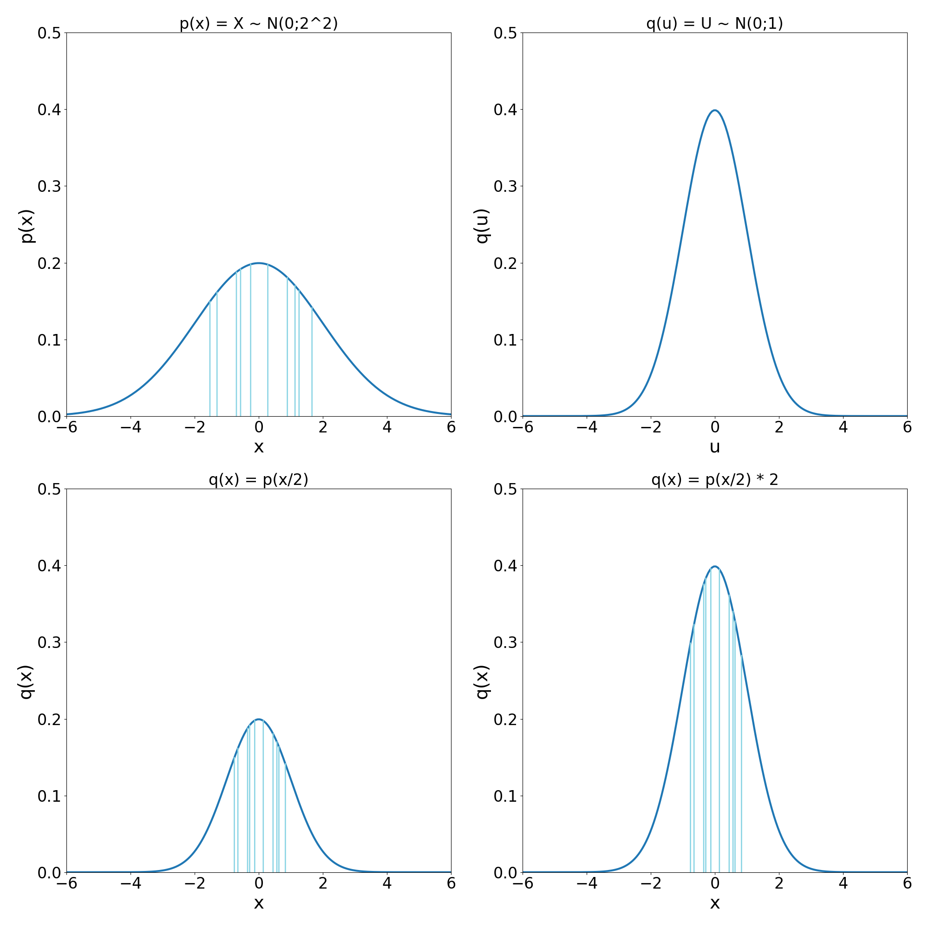
Intro: 1D Transformation

Slide 12
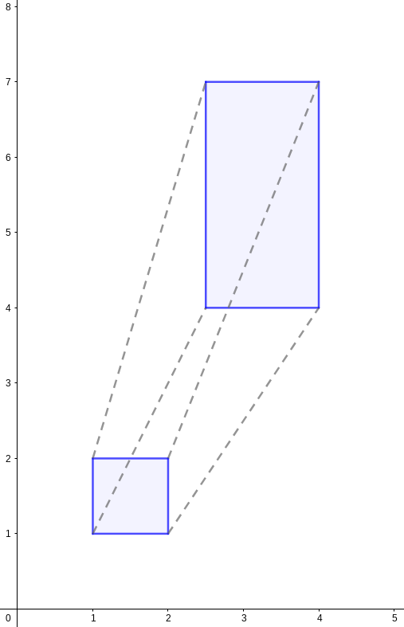
Intro: Jacobian Matrix and Determinant

Slide 13
Intro: Normalising Flows
Normalising Flow formula:
Optimisation target: maximum likelihood
Deep models can be build
Deep models have increased expressiveness

Slide 14
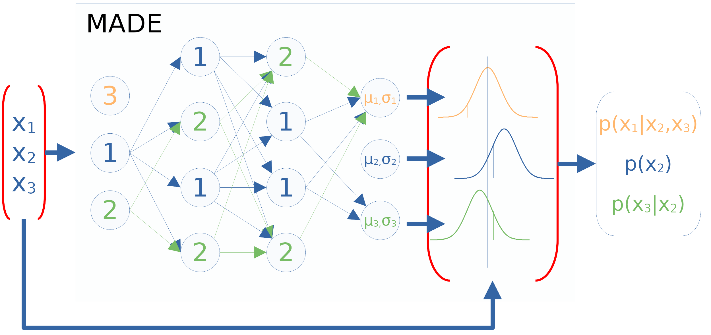
Intro: Autoregression

Slide 15
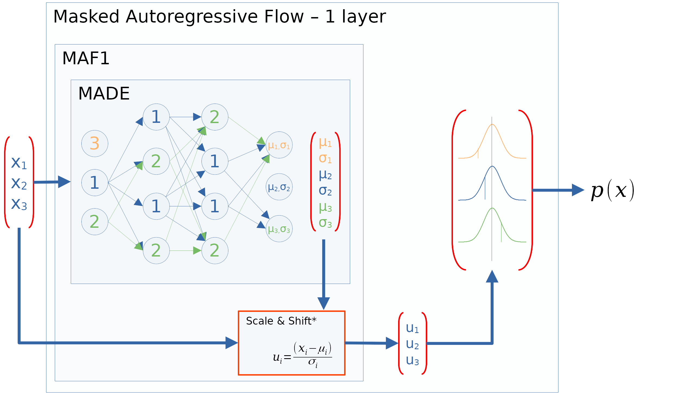
Intro: Masked Autoregressive Flow

Slide 16
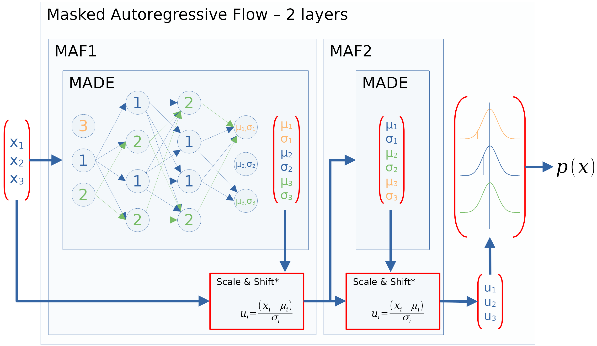
Intro: Deep Masked Autoregressive Flow

Slide 17
Practical Concerns
Density Estimation with artificial distributions
  Measure: KL-divergence
  Experiments:
    Lower dimensions (2D)
    Higher dimensions (10D)
Sampling quality with a real world dataset
  Measure: Accuracy of trained classifiers
  Experiment:
    High dimensional (50D)

Slide 18
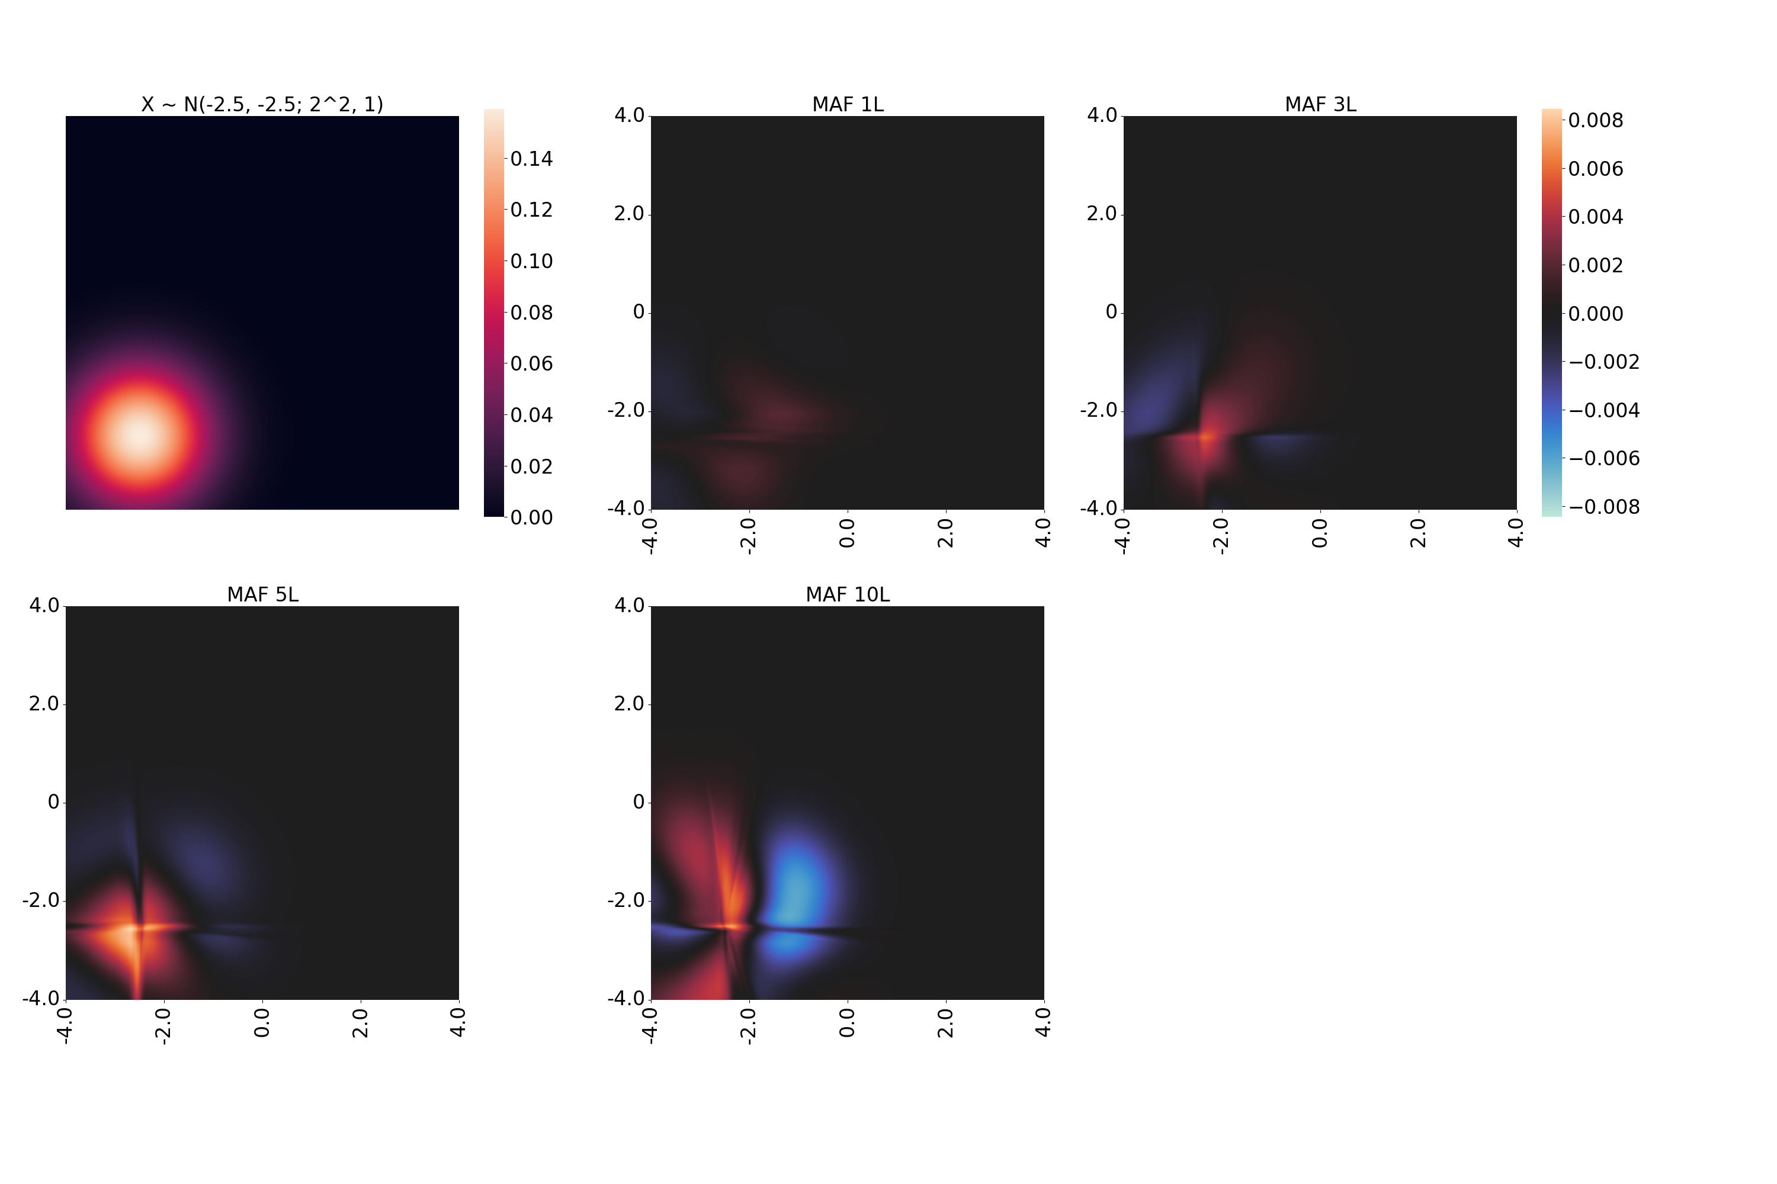
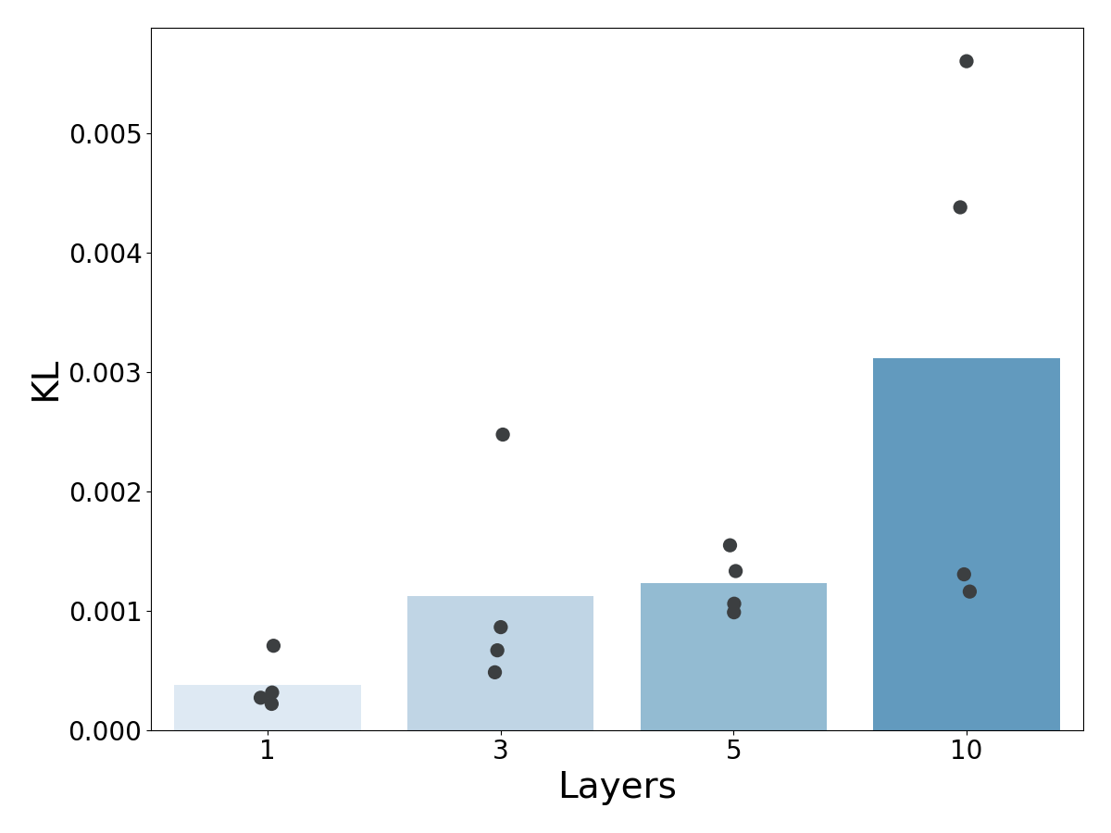
Density Estimation - 2D: 1 Gaussian

Slide 19
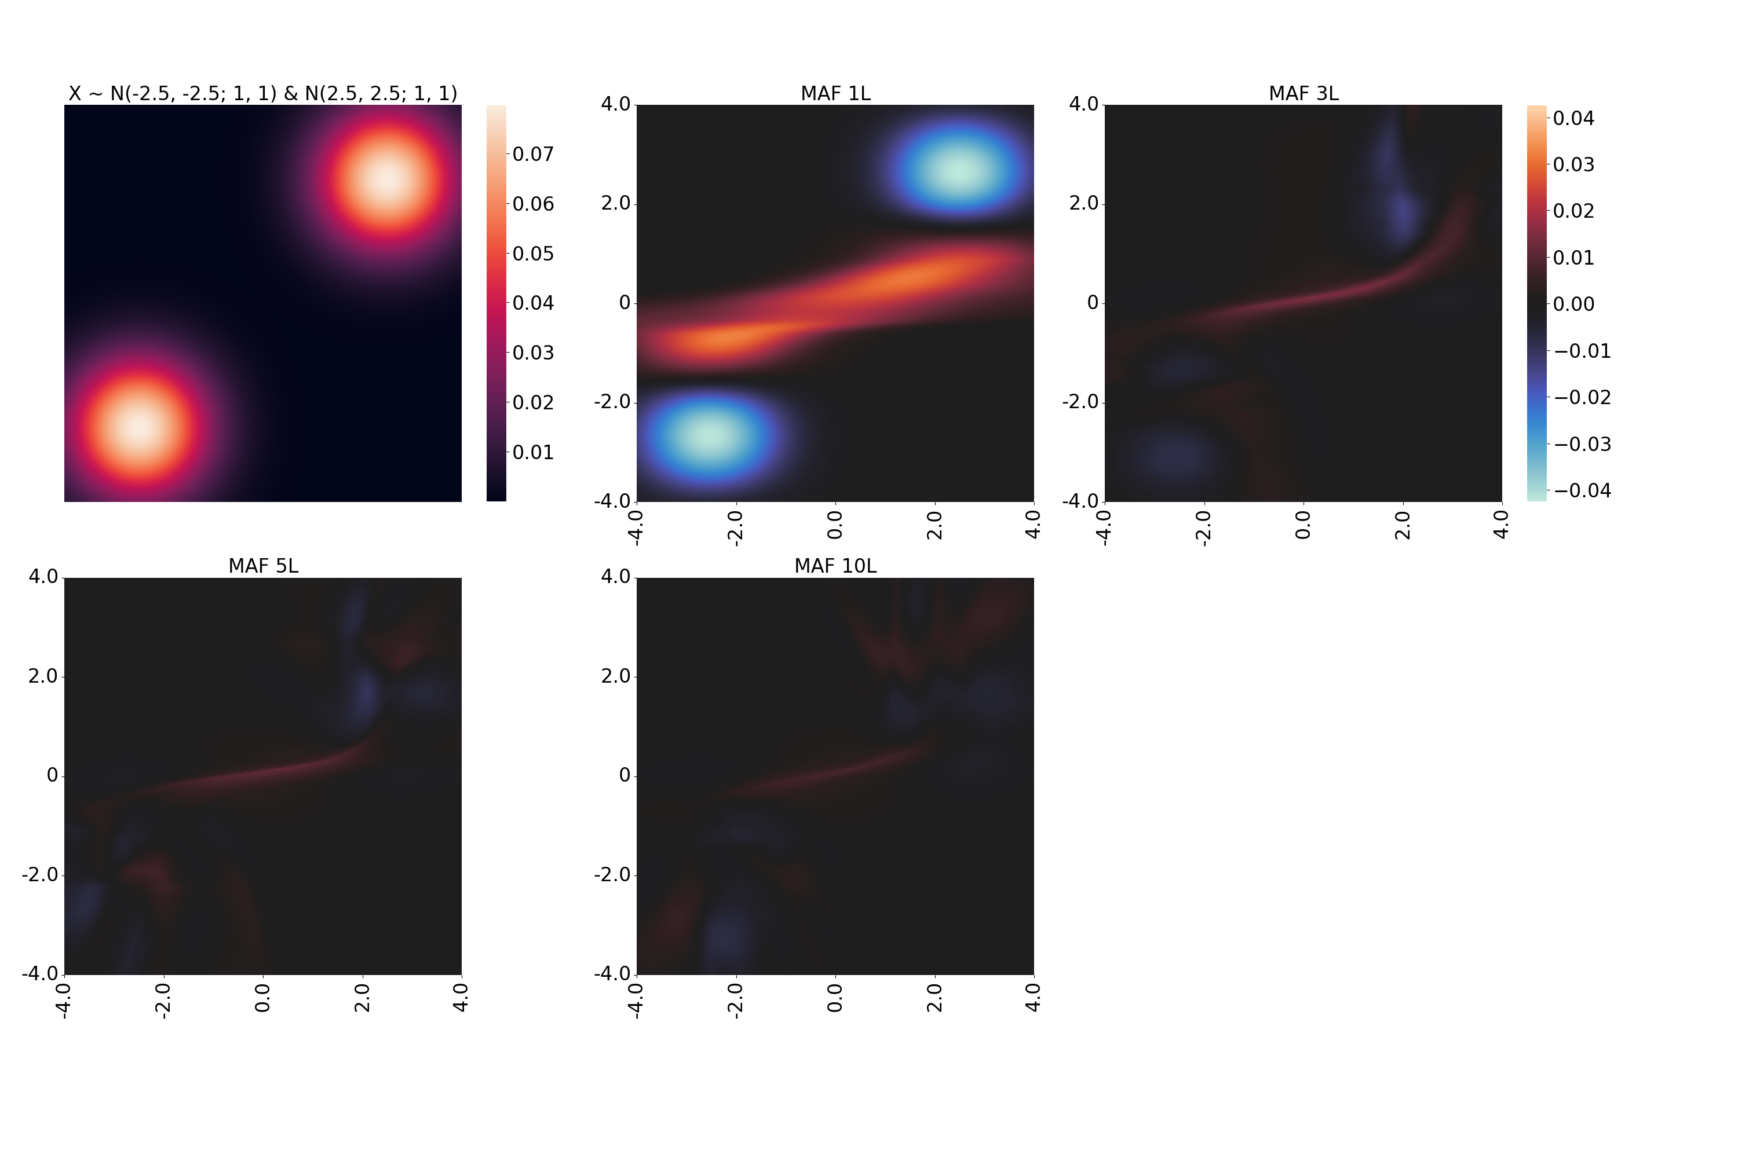
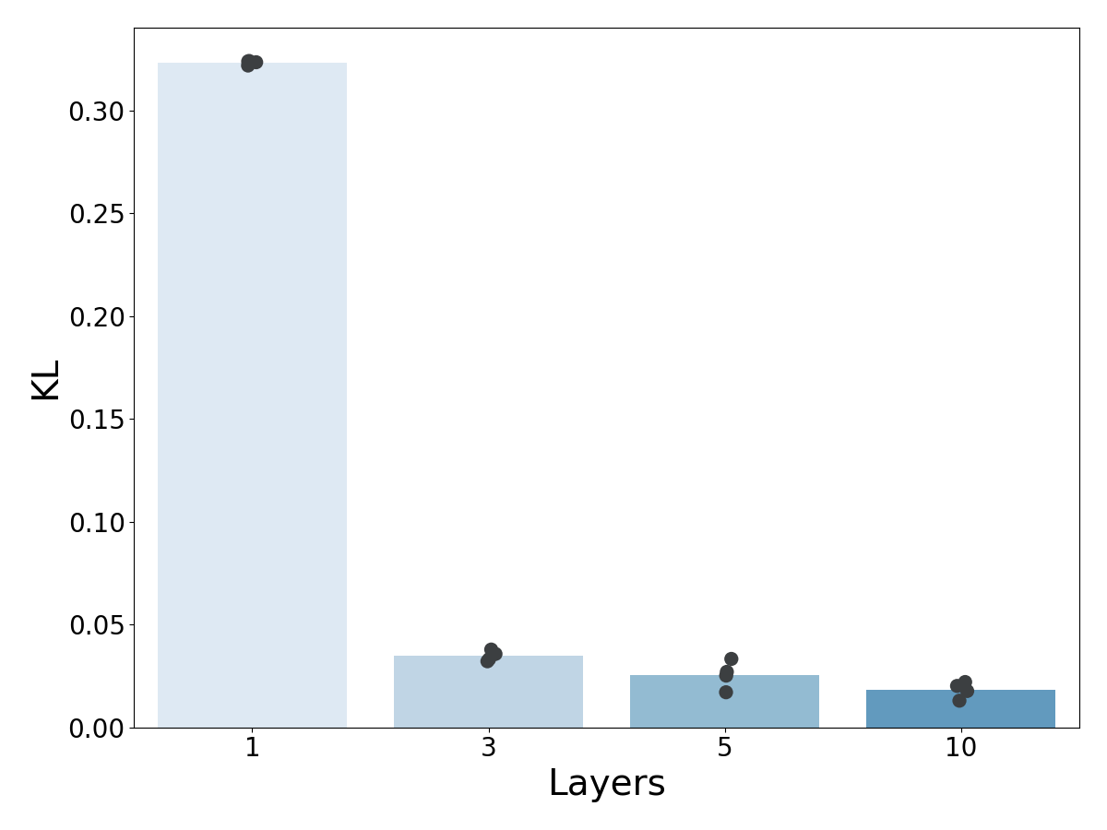
Density Estimation - 2D: 2 Gaussians

Slide 20
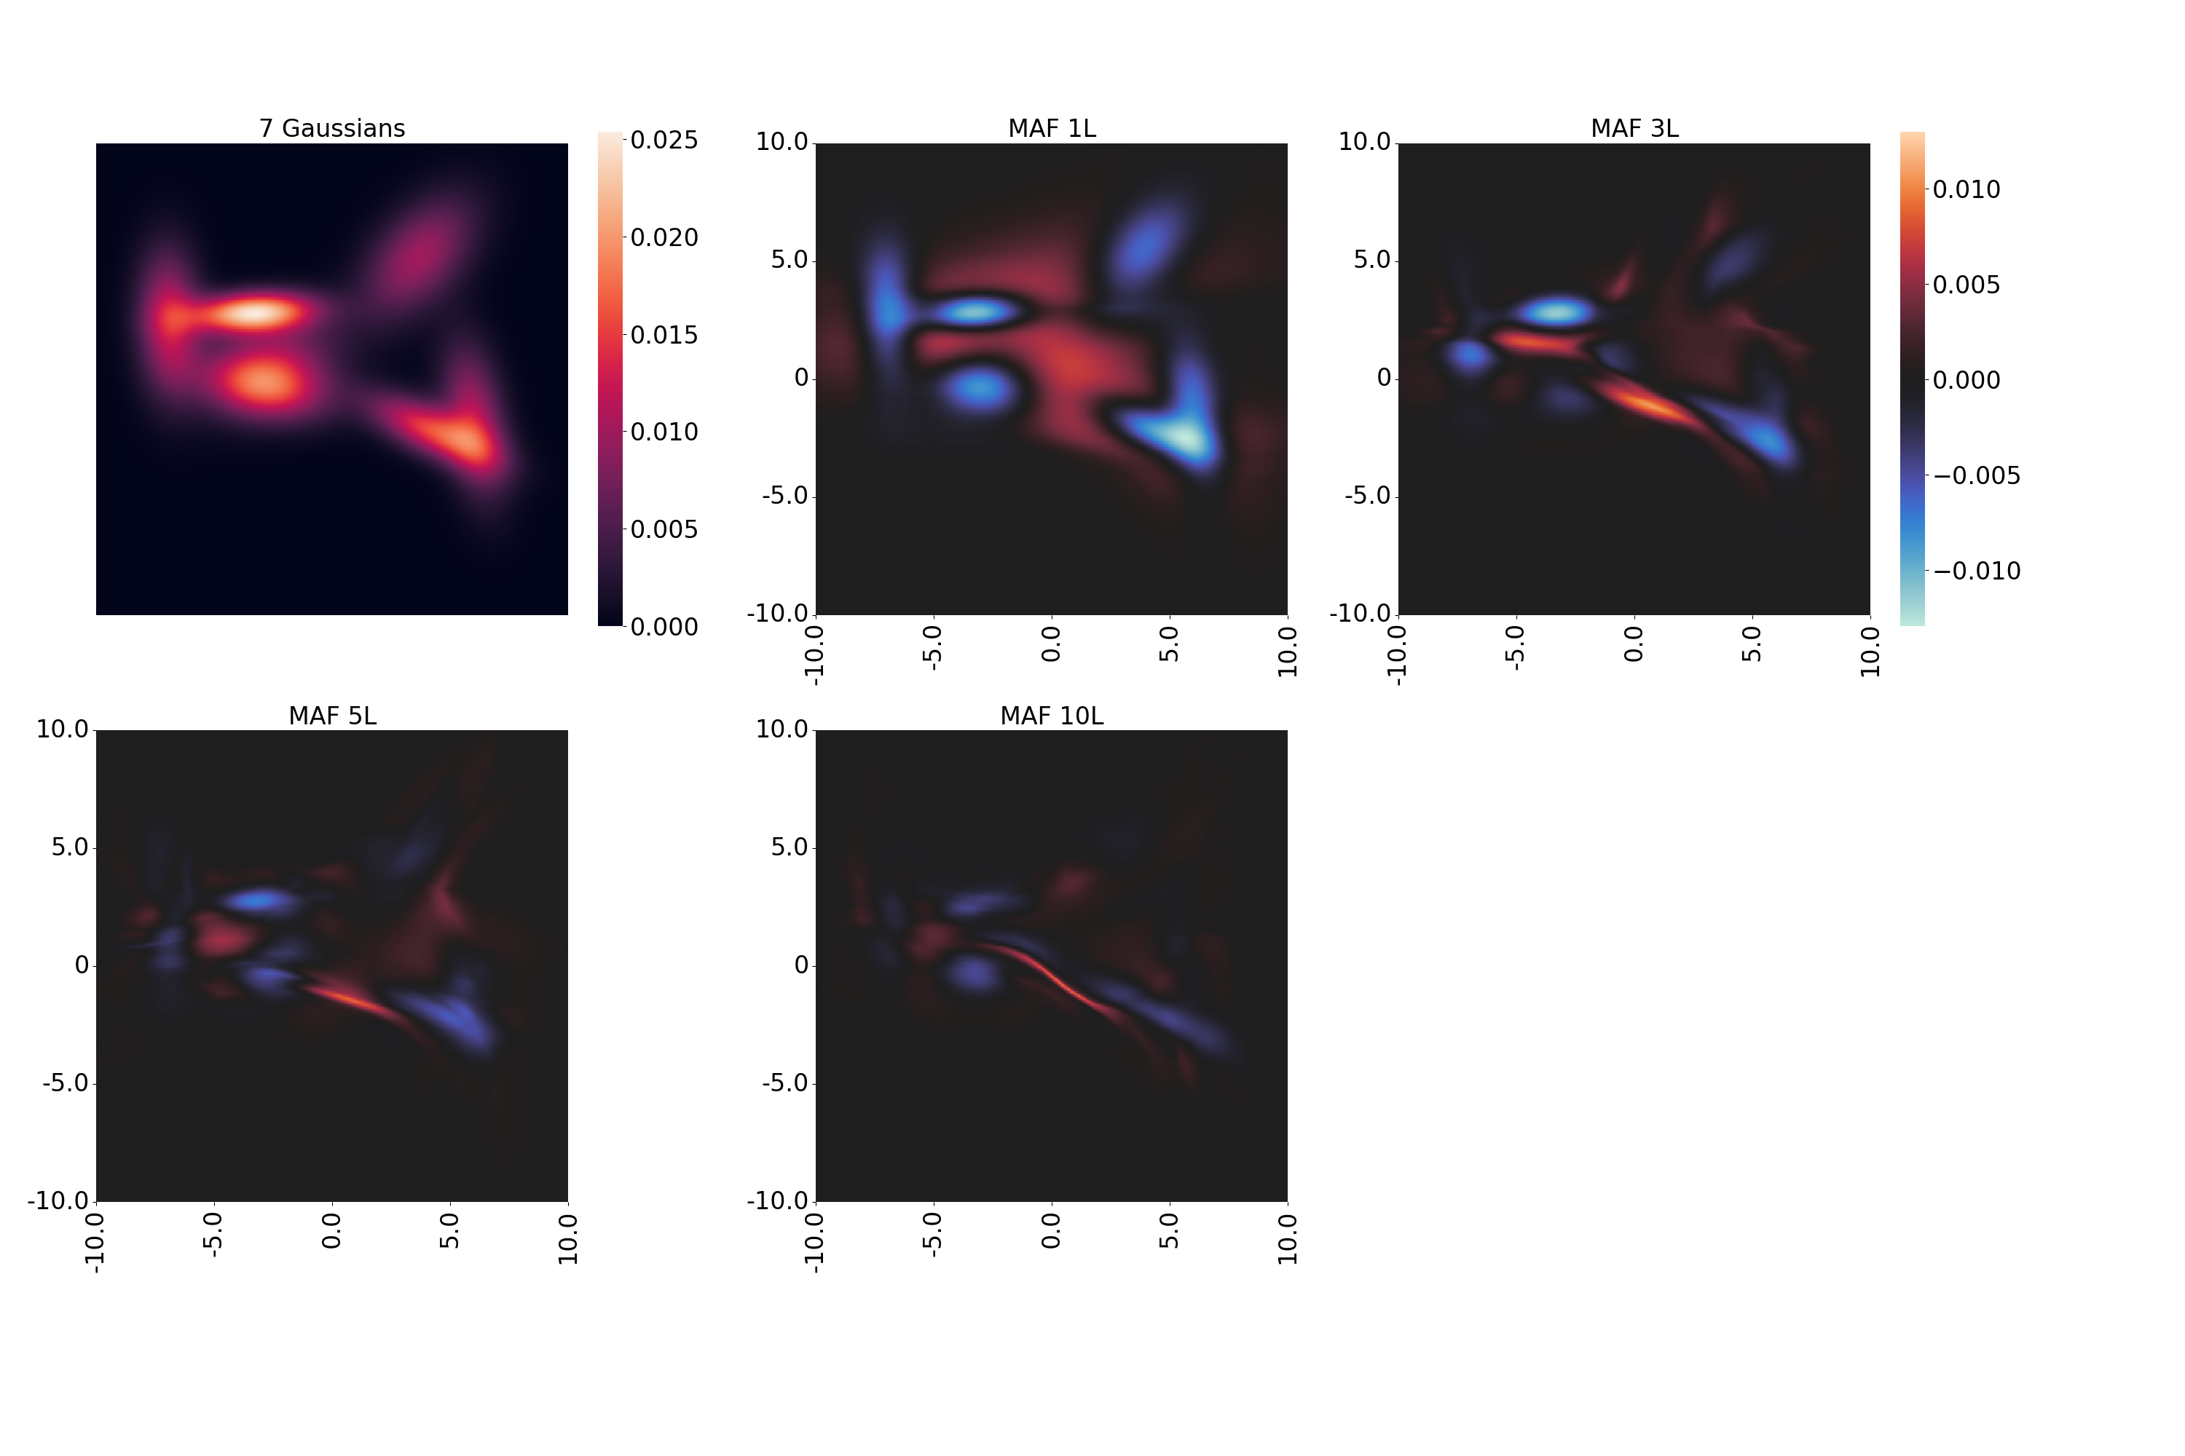
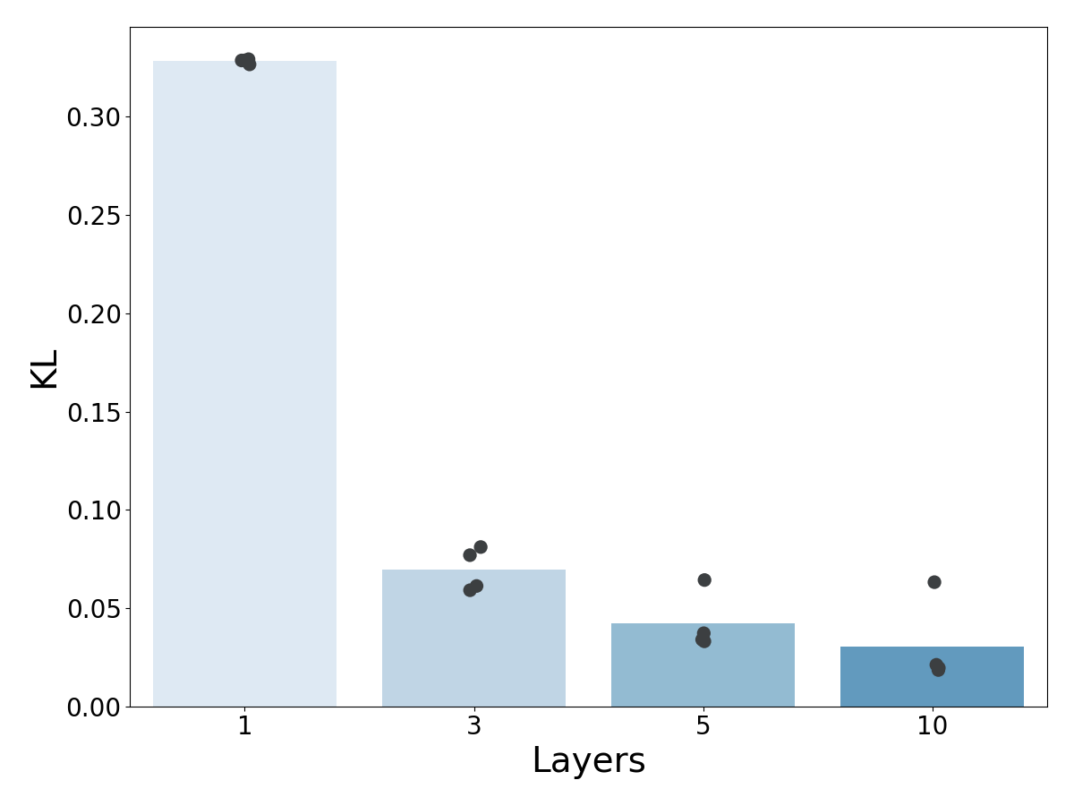
Density Estimation – 2D: 7 Gaussians

Slide 21
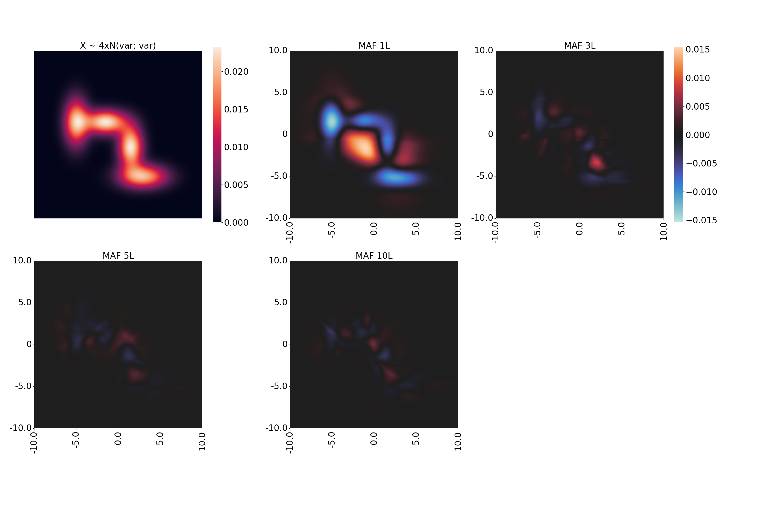
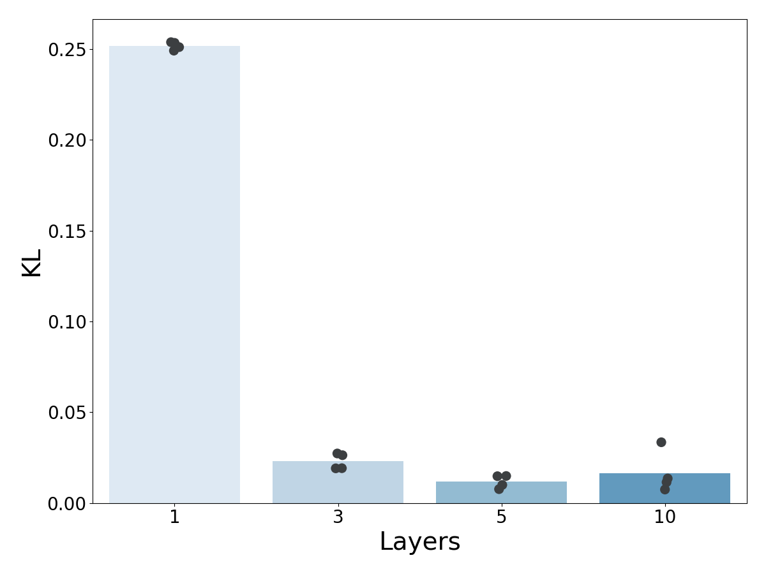
Density Estimation - 2D: 4 Gaussians

Slide 22
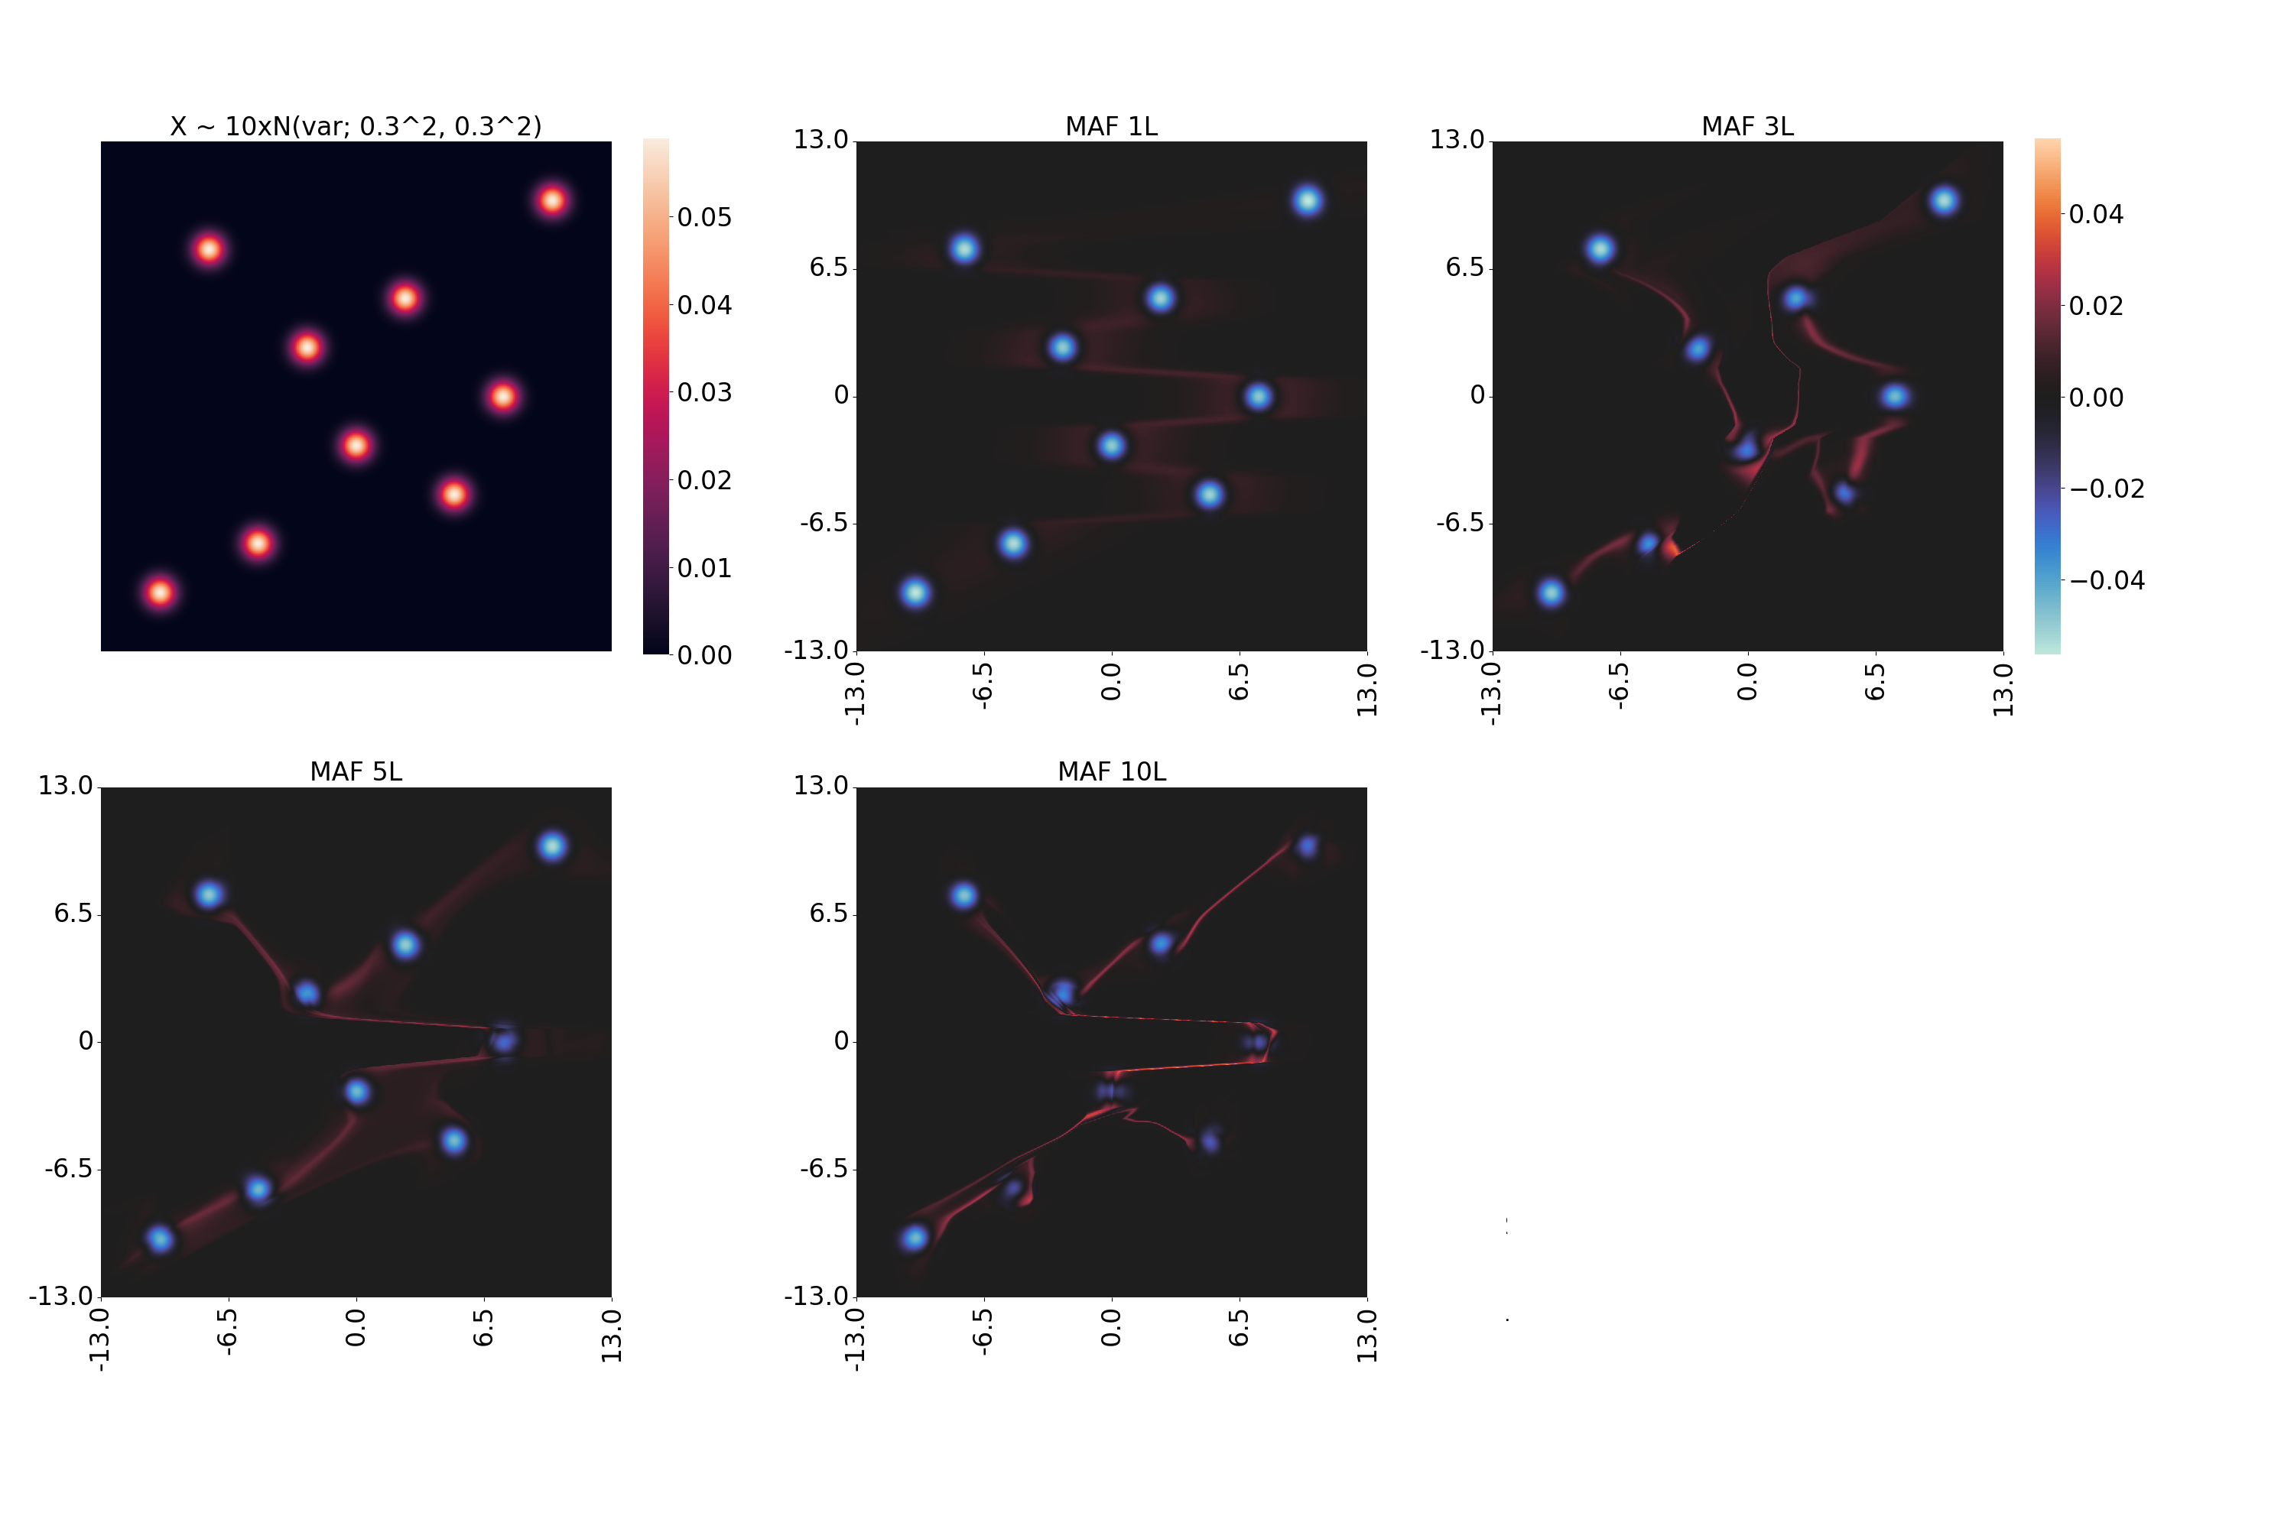
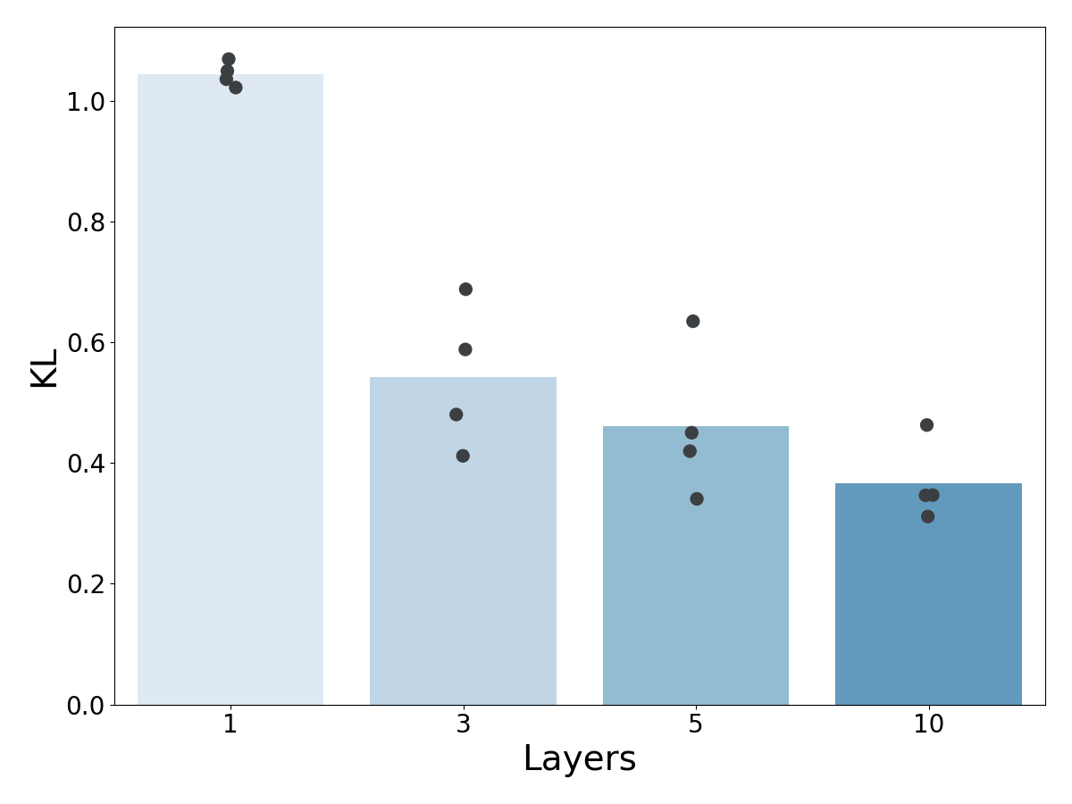
Density Estimation - 2D: 10 Gaussians

Slide 23
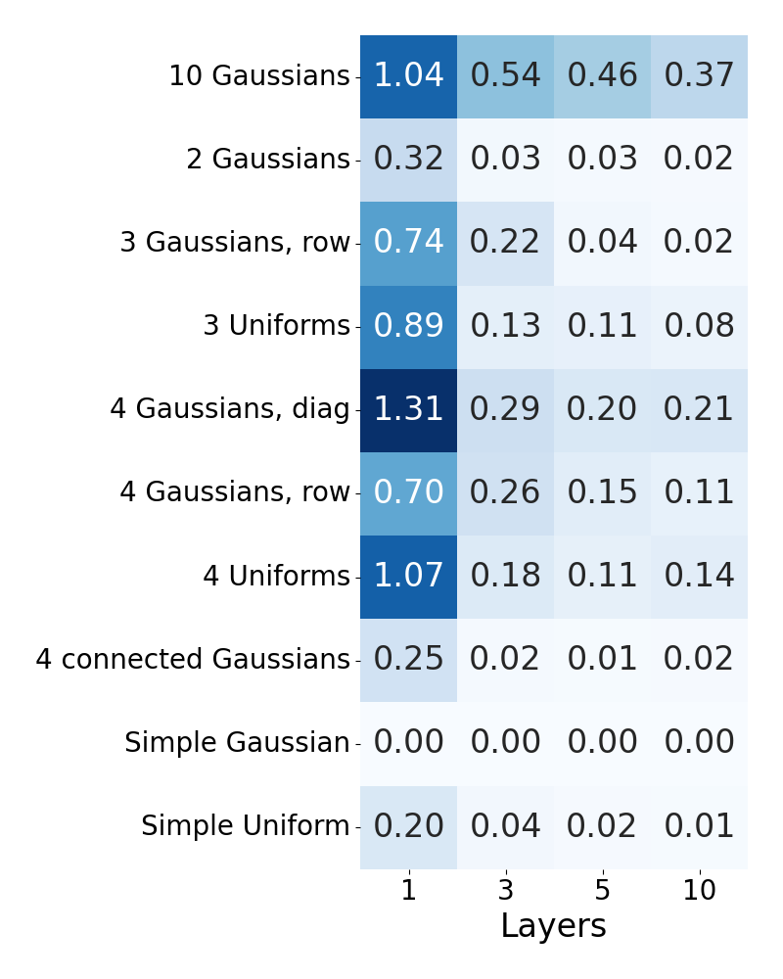
Density Estimation - 2D: KL Overview

Slide 24
Density Estimation - 2D: Summary
Found:
  More layers generally improve results
  Layers >> Dimensions
  ‘Gaps’ increase divergence
Does this hold true for higher dimensions?

Slide 25
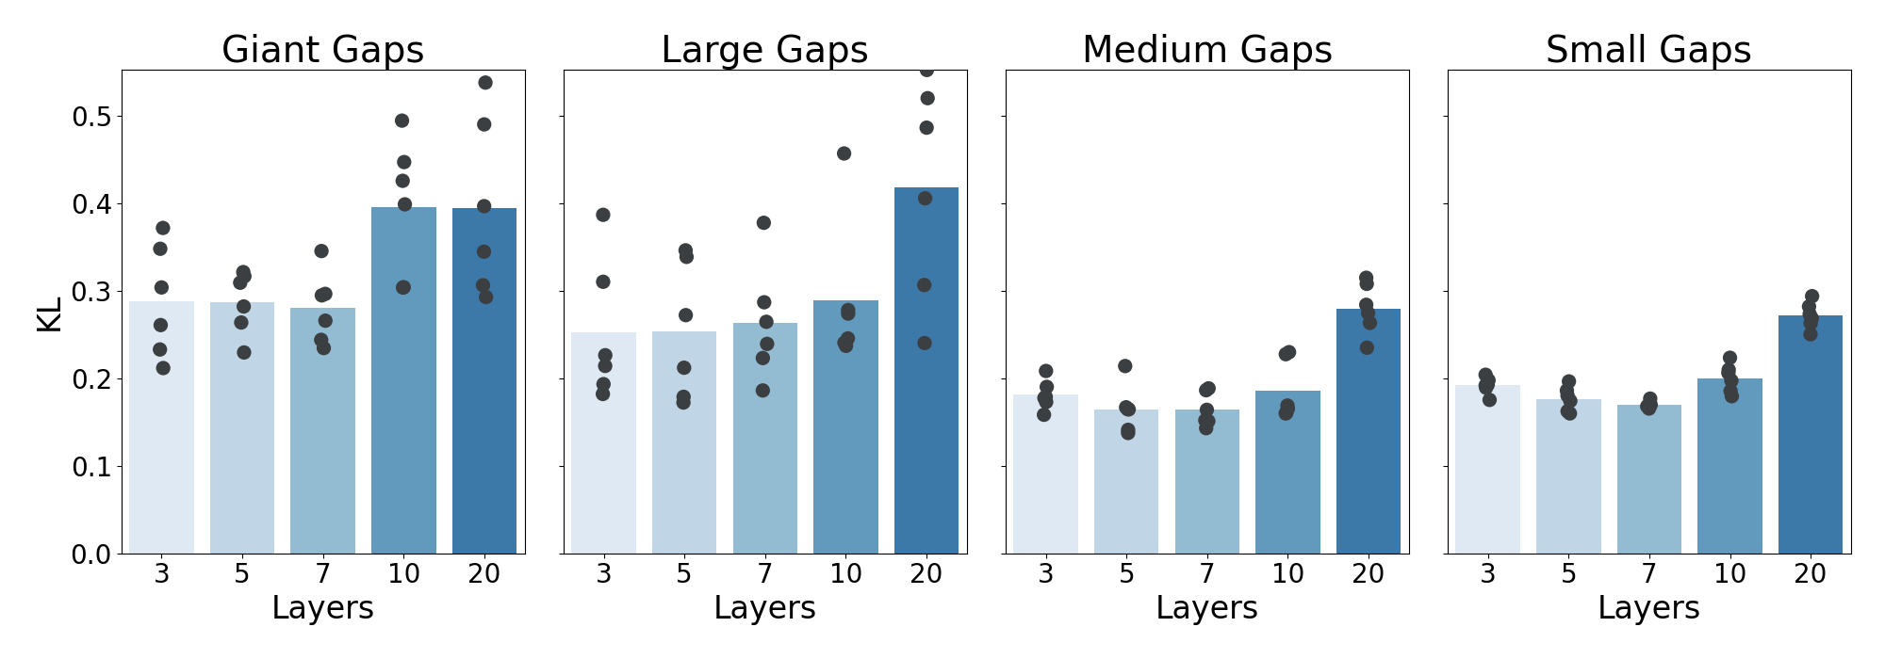
Density Estimation - 10D: Results and overview

Slide 26
Density Estimation - 10D: Summary
Found:
  More layers may make it worse
  5 to 7 layers works best
  Layers < Dimensions
  ‘Gaps’ increase divergence

Slide 27
Sampling Quality: MiniBooNE
50 dimensions
Physical experiment to observe neutrinos
Binary classification problem: signal and noise
~130k samples
  ~70% noise, ~30% signal
Balanced and unbalanced experiment
Experiment
  Fit individual 30 layer MAFs for noise and signal
  Sample synthetic dataset from MAFs
  Fit classifiers with varying amounts of genuine and synthetic samples
  Measure accuracy on test set

Slide 28
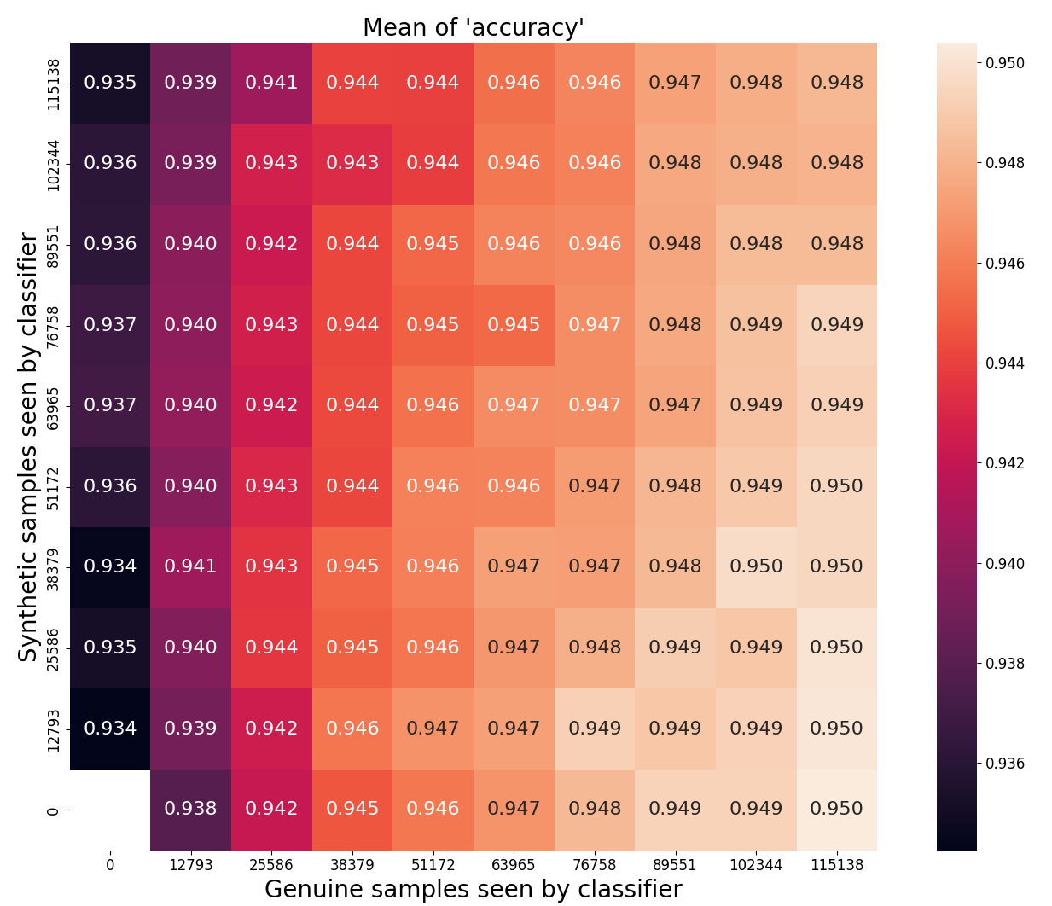
Sampling Quality: MiniBooNE Accuracy

Slide 29
Sampling Quality: MiniBooNE Accuracy

Slide 30
Sampling Quality: MiniBooNE Accuracy

Slide 31
Sampling Quality: MiniBooNE Accuracy

Slide 32
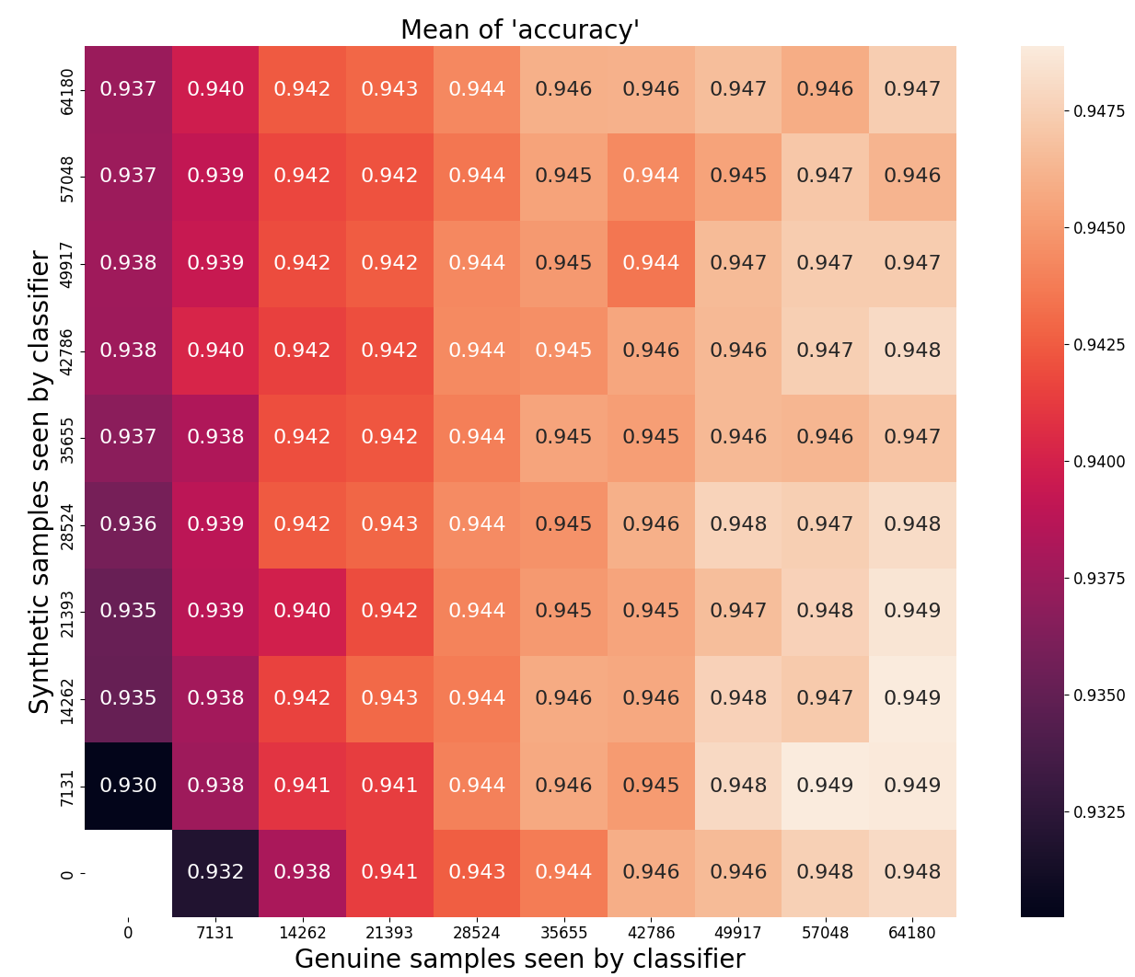
Sampling Quality: MiniBooNE, balanced

Slide 33
Sampling Quality: MiniBooNE, balanced

Slide 34
Sampling Quality: MiniBooNE, balanced

Slide 35
Sampling Quality: MiniBooNE Results
Switching to synthetic samples
  Accuracy drops slightly in all cases
Augmenting synthetic samples
  Complete dataset
    Does no do anything at best
    Augmenting many samples is harmful
  Balanced
    Few additional samples may improve accuracy very slightly
    Augmenting many samples is harmful

Slide 36
Takeaway
MAFs can learn arbitrary distributions
MAFs are easy to tune
MAFs scale well for higher dimensions

Slide 37
The End

Slide 38
Complexity
Calculate inverse of arbitrary function:
Calculate Jacobian determinant of arbitrary transformation:
Adding more layers scales linear

Slide 39
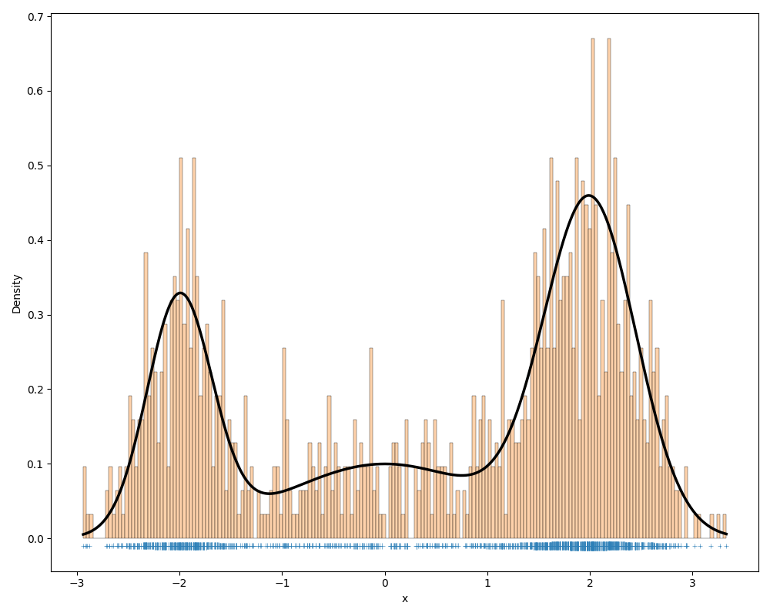
Density Estimation - Histogram

Slide 40
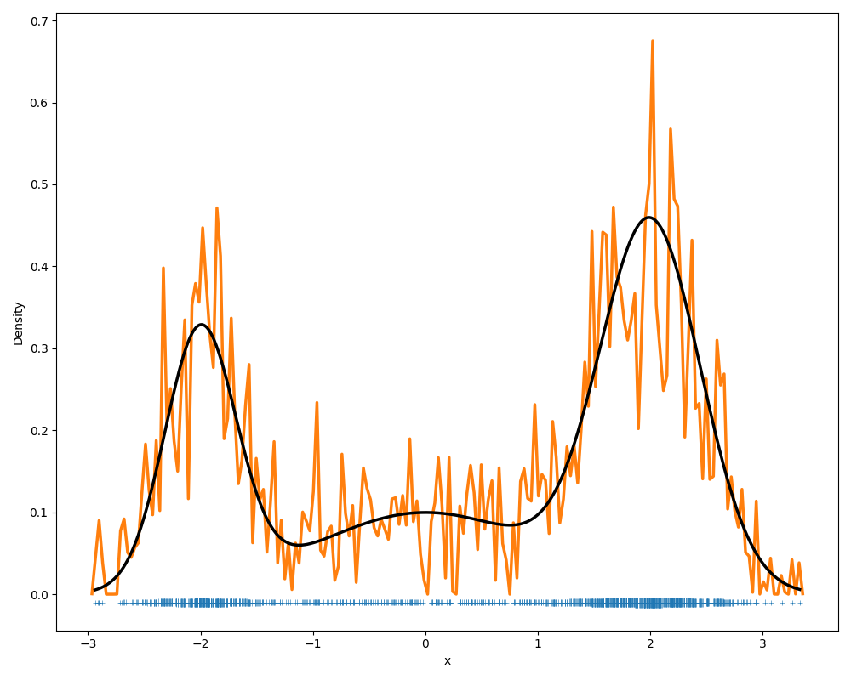
Density Estimation - KDE

